Slide 1
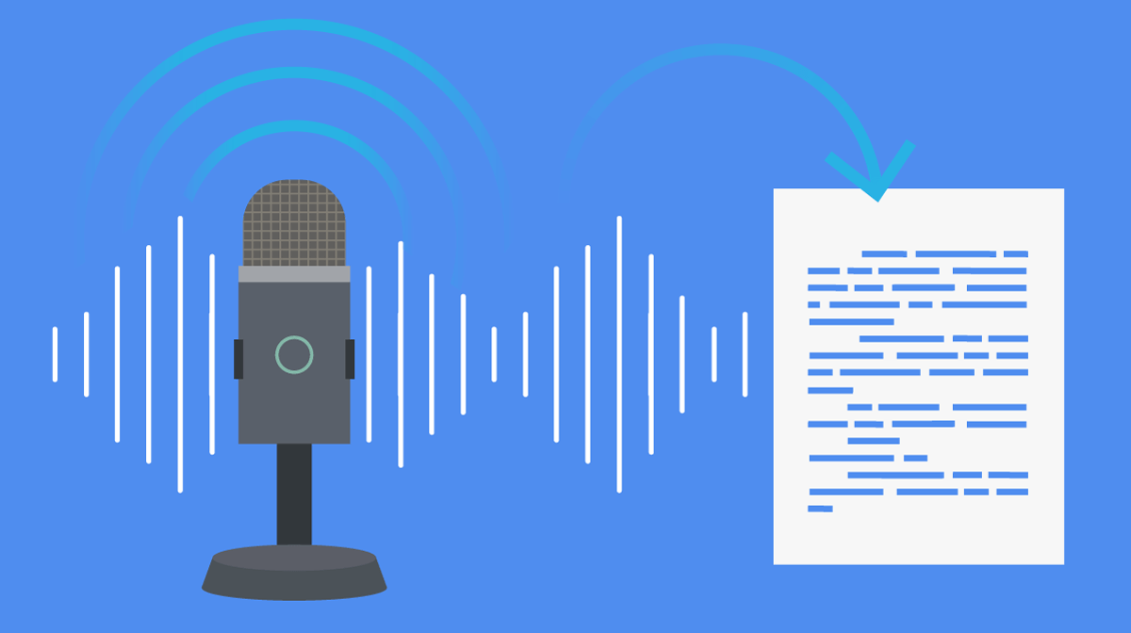
SPEECH-TO-TEXT
Submitted By:
Vigneshwar Muriki
Veda Samhitha Dyawanapally
Deepthi Gade
Mounika Kasaragadda

Slide 2
Description and Uses:
Speech to text, also known as speech recognition or voice recognition, is a process that uses advanced algorithms and machine learning models to convert spoken words into written text.
Applications for speech to text technology include automated speech and interview transcription, real-time closed captioning of live events, text dictation software(Dictation software is often used by people who prefer to speak rather than type, or who have difficulty using a keyboard due to physical disabilities or other conditions), and voice-activated control systems for various appliances and devices(Enable users to control various devices and appliances using voice commands rather than physical buttons or controls).

Slide 3
BASIC CODE
In our Basic Code, with the help of the Speech Recognition Library, the code creates a straightforward web application that lets users record audio input from a microphone and turn it into text.
After that, the generated text is shown on the screen. The app has a single button to begin recording, and before the audio is captured, the microphone's sensitivity is changed.
An appropriate error message is displayed if the speech cannot be recognized or if the request cannot be processed properly. The "Speech to Text" app asks the user to speak after they click the "Start Recording" button, and the spoken words are then displayed as text on the screen.

Slide 4
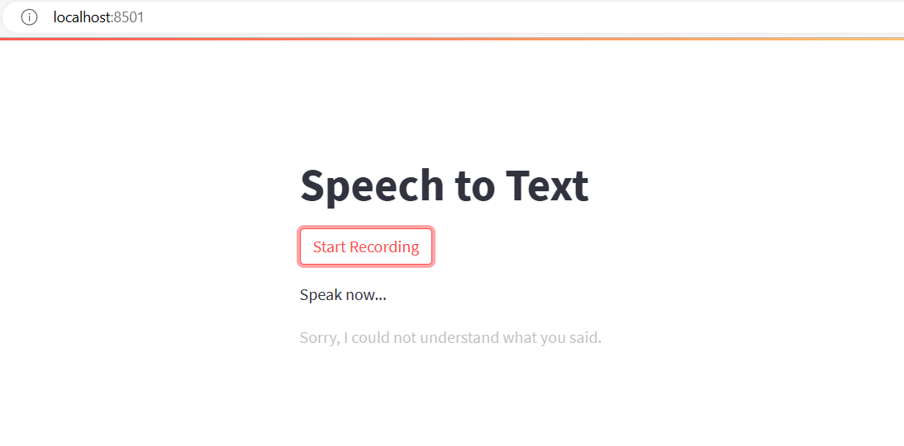
Initial Page

Slide 5
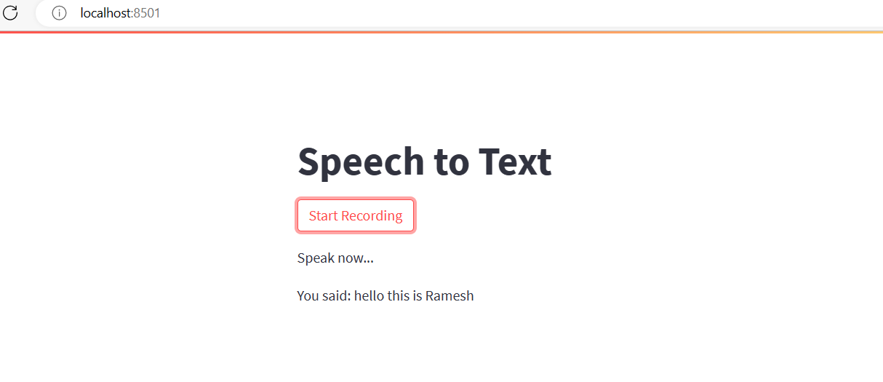
Test 1: Start recording and get correct output.

Slide 6
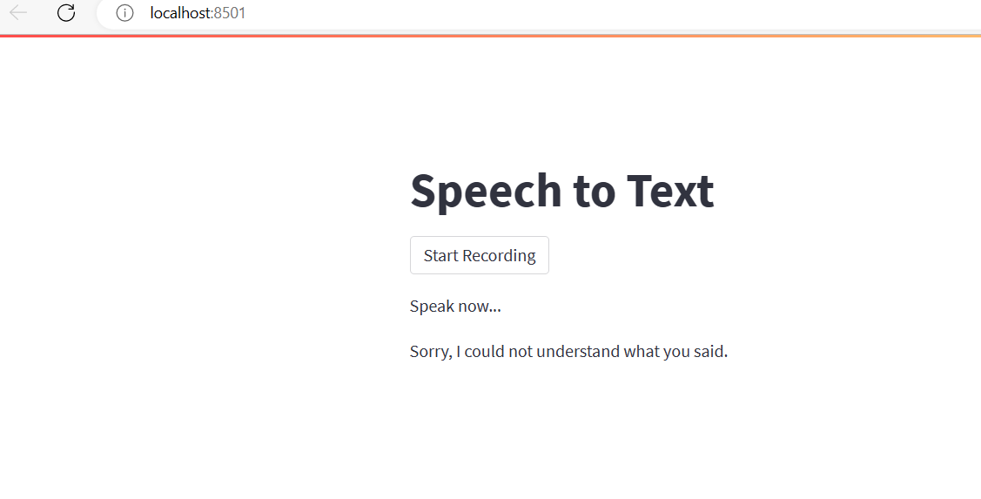
Test 2: Error check when no one talks.

Slide 7
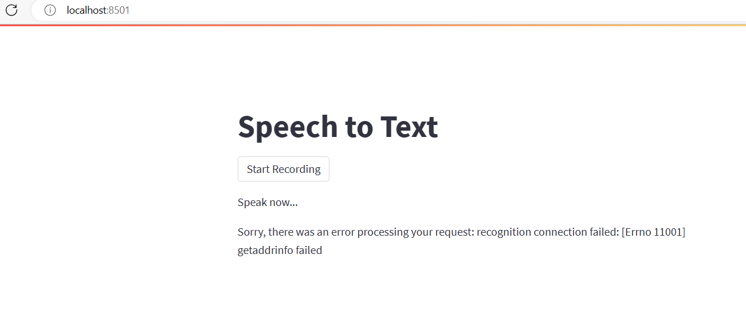
Test 3: Network Failure

Slide 8
Feature 1: Highlights keywords in Yellow.
In the before basic code, we have added an additional feature that highlights keywords in Yellow and we can add as many keywords in the Code as per the usage of the project.
When certain words or phrases need to be highlighted to catch the user's attention or are particularly important, this feature may be helpful. For instance, a teacher might want to highlight important vocabulary words in the transcription text of a speech-to-text application for a language learning platform to aid their students in identifying and learning new words.

Slide 9
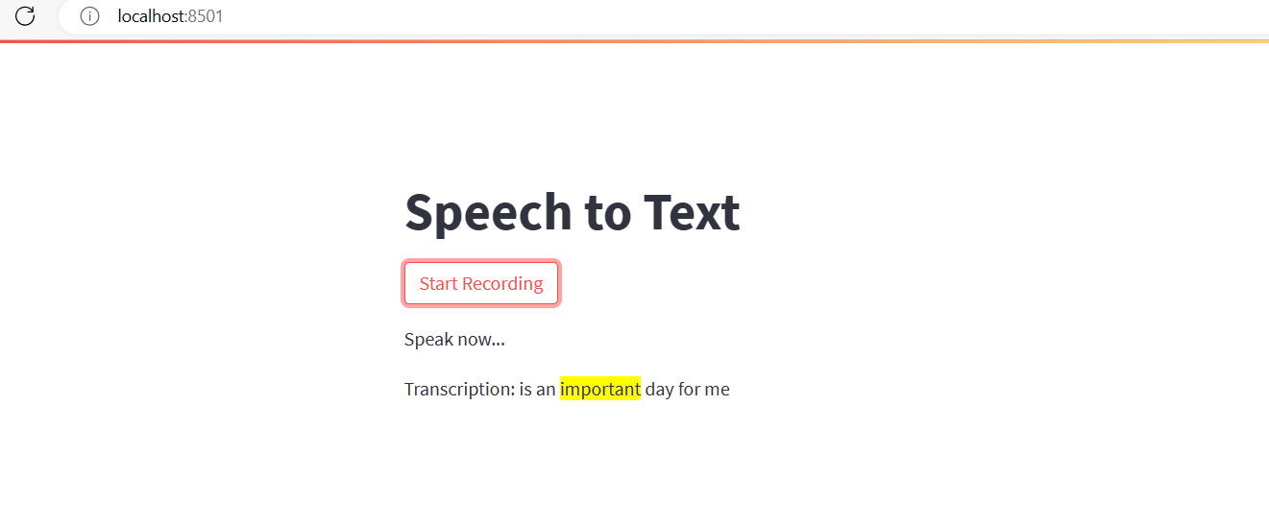
Output:

Slide 10
Feature 2: Detection of sensitivity of the output text using Sentiment Analysis.
The resulting text is displayed on the screen along with the sentiment analysis of the text.
This feature can be helpful in a variety of contexts where it's critical to comprehend the tone of the customer's voice, such as market research or customer service. The tone of the user's voice can be used to customize the response or course of action in personal assistants as well. The user experience can be enhanced by determining whether a text's sentiment is positive, negative, or neutral by conducting a sentiment analysis.

Slide 11
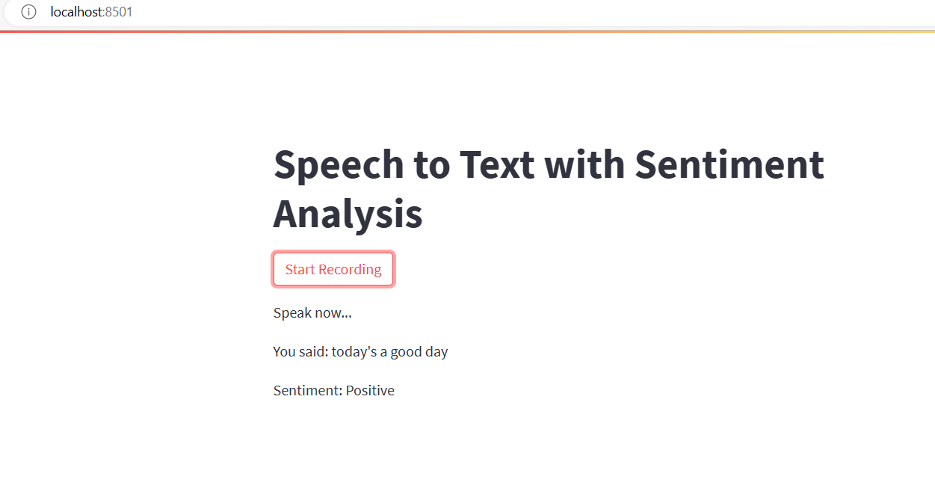
Output: Positive

Slide 12
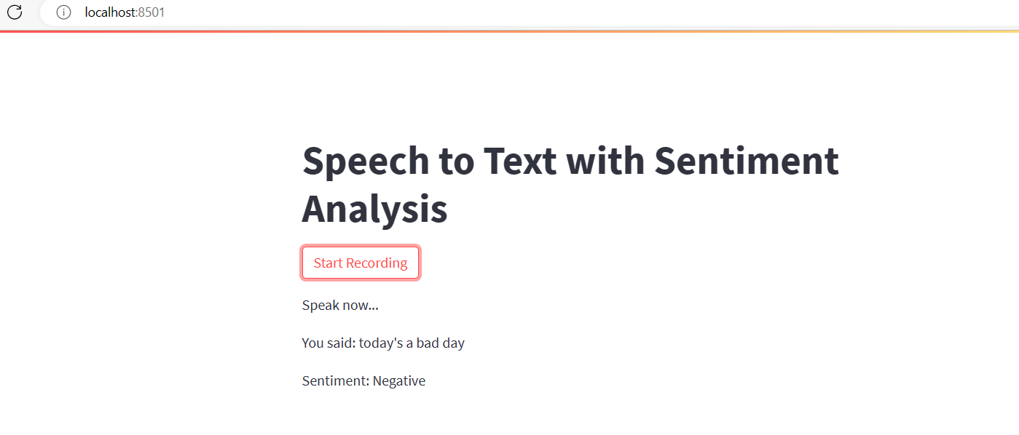
Output: Negative

Slide 13
Feature 3:Edit the Output Transcription Text
This code provides a feature that allows the user to edit the text output from the speech-to-text conversion.
This can be useful in case the transcription is not accurate or if the user wants to make any changes to the text before proceeding.

Slide 14
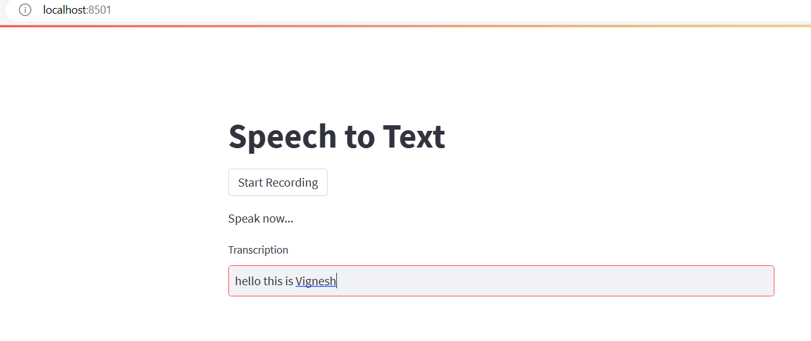
Initial Output:

Slide 15
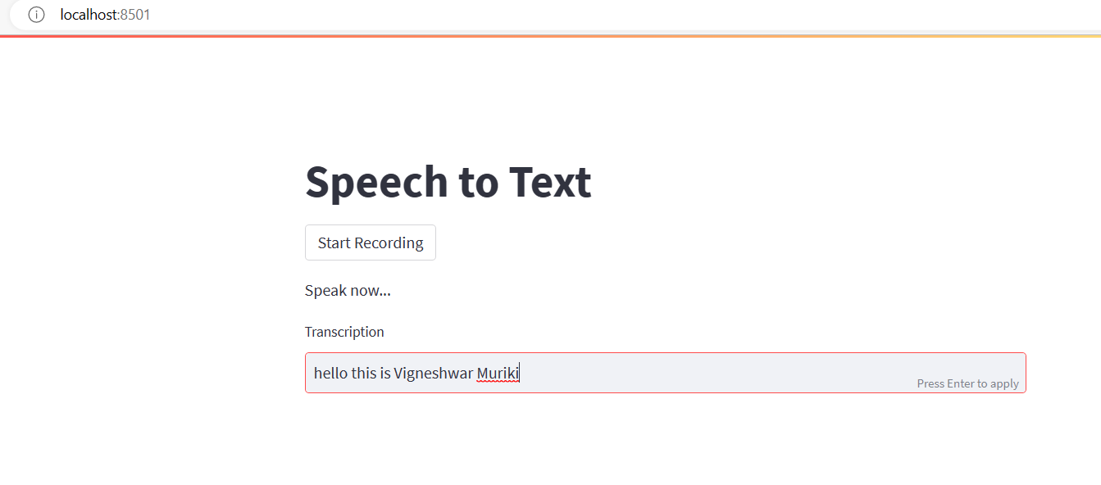
Final Output after editing:

Slide 16
Feature 4: Download the output transcription text.
This feature allows the users to download the output transcription text in PDF or Microsoft Word Format.
Note: This feature is not yet working, but we are trying to implement it.
The user can download the output transcription text and save it as a file for later use or reference thanks to this feature. This function can be helpful for recording crucial meetings, interviews, or other spoken content that might need to be referred to later. Additionally, the downloaded file can be distributed to people who might not have access to the original recording.

Slide 17
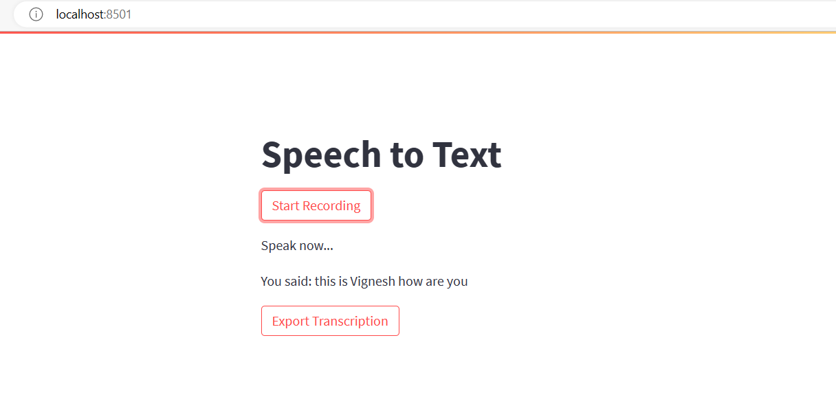
Output:

Slide 18
Challenges:
Downloading Transcription output is not yet working, we will try to implement it.
Tried to merge all the features in one code, but we will try to implement it.

Slide 19


